Slide 1
MODULE 4
Association Rule Analysis

Slide 2
Association Rules-Introduction
Association rule mining finds interesting associations and relationships among large sets of data items.
This rule shows how frequently a itemset occurs in a transaction.
A typical example is a Market Based Analysis.
It allows retailers to identify relationships between the items that people buy together frequently.

Slide 3
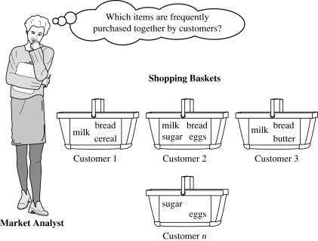

Slide 4
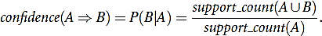
•
Association Rule – An implication expression of the form A -> B,
where A and B are any 2 itemsets.
Measures for Rule Creation
1. The support for A→B is the probability of both A and B appearing
together, that is P(A U B).
support(AUB) = P(AꓴB)
1. The confidence of A→B is the conditional probability of A appearing given that B exists. It is written as P(A|B) and read as P of A given B.

Slide 5
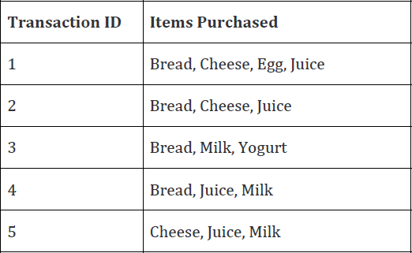
Example-Find support value of each itemset
Support (item) = Frequency of item/Number of transactions

Slide 6
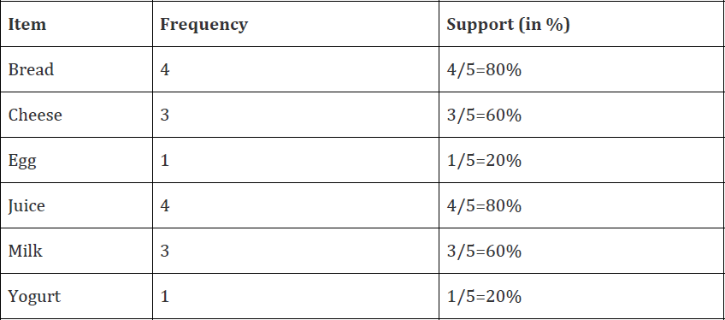
Answer:

Slide 7
Methods to discover Association rules
In general, association rule mining can be viewed as a two-step process:
Find all frequent itemset: By definition, each of these itemset will occur at least as frequently as a predetermined minimum support count
Generate strong association rules from the frequent itemset: By definition, these rules must satisfy minimum support and minimum confidence.

Slide 8
Frequent Item Set
Let T be the transaction database and a be the user-specified minimum support σ.
An itemset X ϵ A is said to be a frequent itemset in T with respect to
σ, if
Support(X) ≥ σ
: Any subset of a frequent set is a
Downward Closure Property
frequent set.
Upward Closure Property: Any superset of an infrequent set is an
infrequent set.

Slide 9
Maximal Frequent Set
A frequent set is a maximal frequent set if it is a frequent set and no superset of this is a frequent set.
Border Set
An itemset is a border set if it is not a frequent set, but all its proper subsets are frequent sets

Slide 10
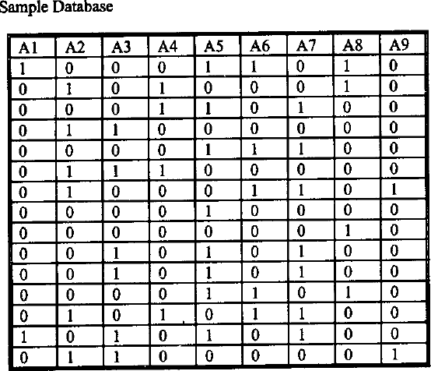
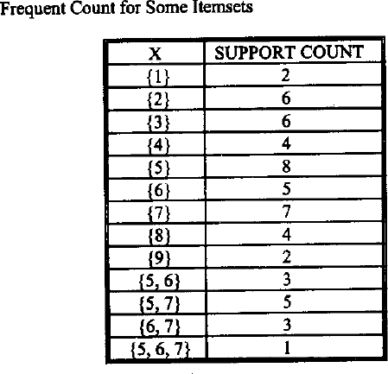
(A1, A2, A3, A4, A5, A6, A7, A8, A9). Assume support= 20%.

Slide 11
{1} – Not a frequent set
{3} - is a frequent set
{5, 6, 7} - is a border set
{5, 6} - is a maximal frequent set
{2, 4} - is also a maximal frequent set
But there is no border set having {2, 4} as a proper subset

Slide 12
APRIORI ALGORITHM
It is also called the level-wise algorithm
Apriori algorithm may be simply described by a two step approach:
Step 1 ─ discover all frequent (single) items that have support above
the minimum support required
Step 2 ─ use the set of frequent items to generate the association
rules that have high enough confidence level
•
The candidate generation process and the pruning process are the
most important parts of this algorithm

Slide 13
The candidate-generation method
Given 𝐿_{𝑘−1}, the set of all frequent (k-1)-itemset, we want to generate a superset of the set of all frequent k-itemset.
Using this algorithm: from L3 := { 1, 2, 3}, {1, 2, 5}, {1, 3, 5}, {2, 3, 5}, {2, 3, 4}).
C4 := { 1, 2, 3, 5 }, {2, 3, 4, 5} }
{1, 2, 3, 5} is generated from {1, 2, 3} and {1, 2, 5}.
Similarly, {2, 3, 4, 5} is generated from {2, 3, 4} and {2, 3, 5}.
Pruning
The pruning step eliminates the extensions of (k-1)-itemset which are not
found to be frequent, from being considered for counting support.
For example, from C4, the itemset {2, 3, 4, 5} is pruned, since all its 3-subsets are not in L3

Slide 14
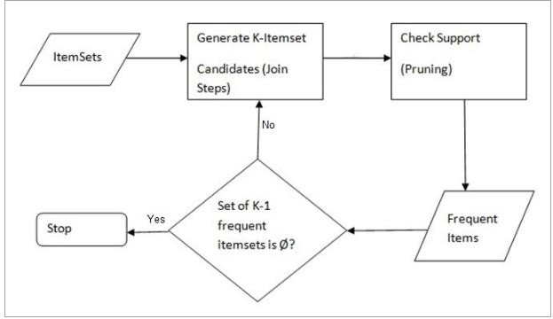

Slide 15
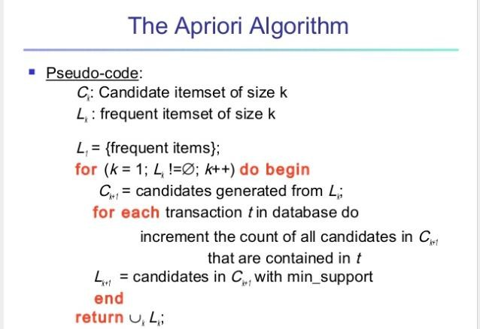

Slide 16
Example
Find association rules with minimum support of 50% and minimum confidence of 75%.
Transaction ID | Items
100 | Bread, Cheese, Eggs, Juice
200 | Bread, Cheese, Juice
300 | Bread, Milk, Yogurt
400 | Bread, Juice, Milk
500 | Cheese, Juice, Milk

Slide 17
Example
First find L1. 50% support requires that each frequent item appear in at least three transactions. Therefore L1 is given by:
Item | Frequnecy
Bread | 4
Cheese | 3
Juice | 4
Milk | 3

Slide 18
Example
The candidate 2-itemsets or C2 therefore has six pairs (why?). These pairs and their frequencies are:
Item Pairs | Frequency
(Bread, Cheese) | 2
(Bread, Juice) | 3
(Bread, Milk) | 2
(Cheese, Juice) | 3
(Cheese, Milk) | 1
(Juice, Milk) | 2

Slide 19
Deriving Rules
L2 has only two frequent item pairs {Bread, Juice} and {Cheese, Juice}. After these two frequent pairs, there are no candidate 3-itemsets
Apriori property that all subsets of a frequent itemset must also be frequent
The two frequent pairs lead to the following possible rules:
Bread → Juice Juice → Bread Cheese → Juice Juice → Cheese

Slide 20

The confidence of these rules is obtained by dividing the support for both items in the rule by the support of the item on the left hand side of the rule.
The confidence of the four rules therefore are
(Bread → Juice) ----- 3/4 = 75%
support(Bread → Juice)
3
4
confidence(Bread → Juice) =
=
𝑠𝑢𝑝𝑝𝑜𝑟𝑡(𝐵𝑟𝑒𝑎𝑑)
(Juice → Bread) ------ 3/4 = 75% (Cheese → Juice) ----- 3/3 = 100% (Juice → Cheese) ----- 3/4 = 75%
Since all of them have a minimum 75% confidence, they all qualify.

Slide 21
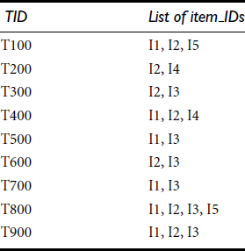
Problem 2
Find Association rules from the following data using Apriori algorithm with minimum support count required is 2 and confidence 70%

Slide 22
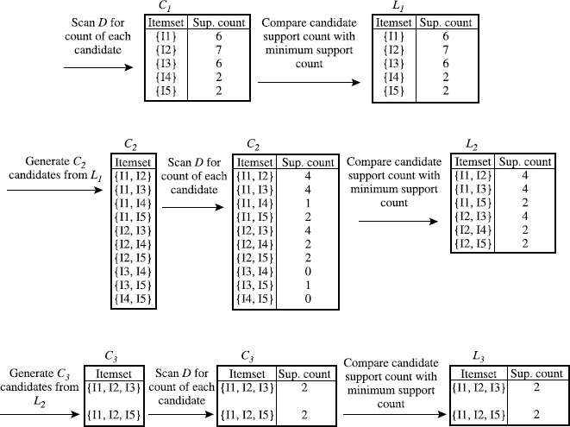
Solution

Slide 23
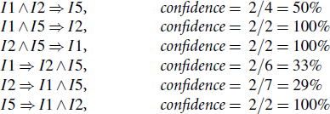
If the minimum confidence threshold is, say, 70%, then only the second, third, and last rules above are output, because these are the only ones generated that are strong.

Slide 24
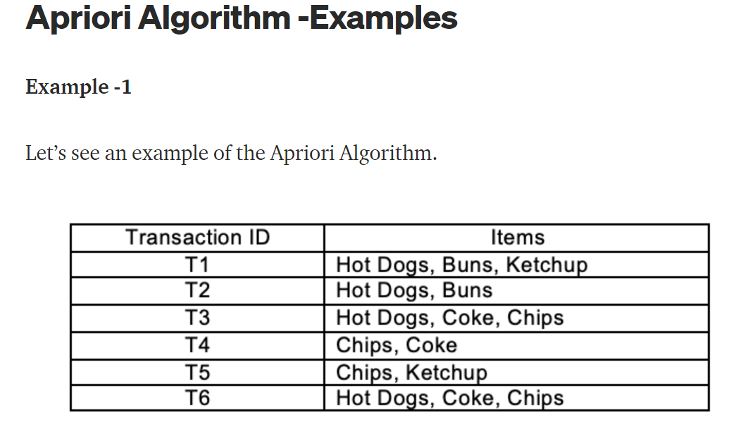

Slide 25
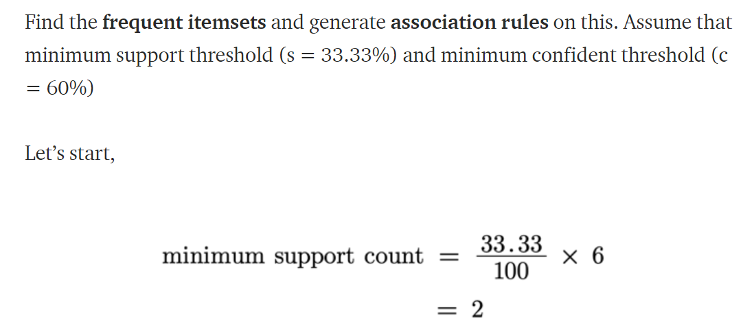

Slide 26
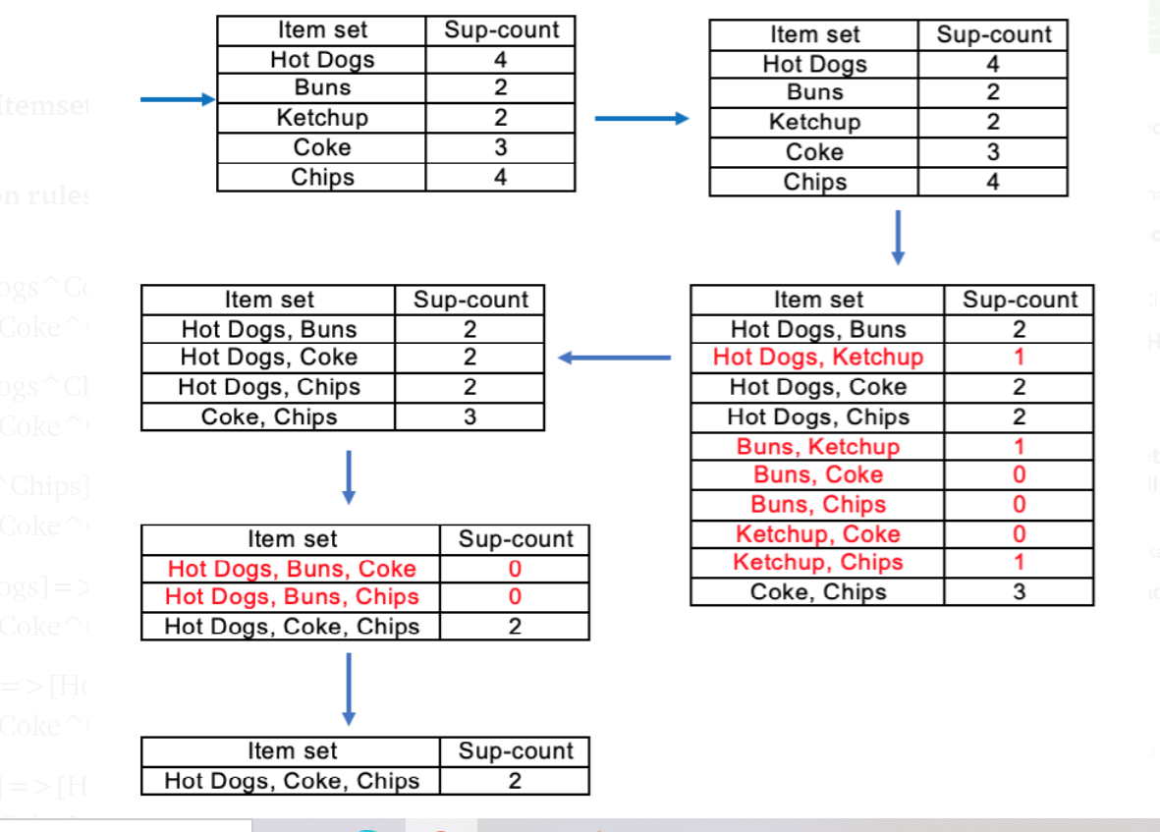

Slide 27
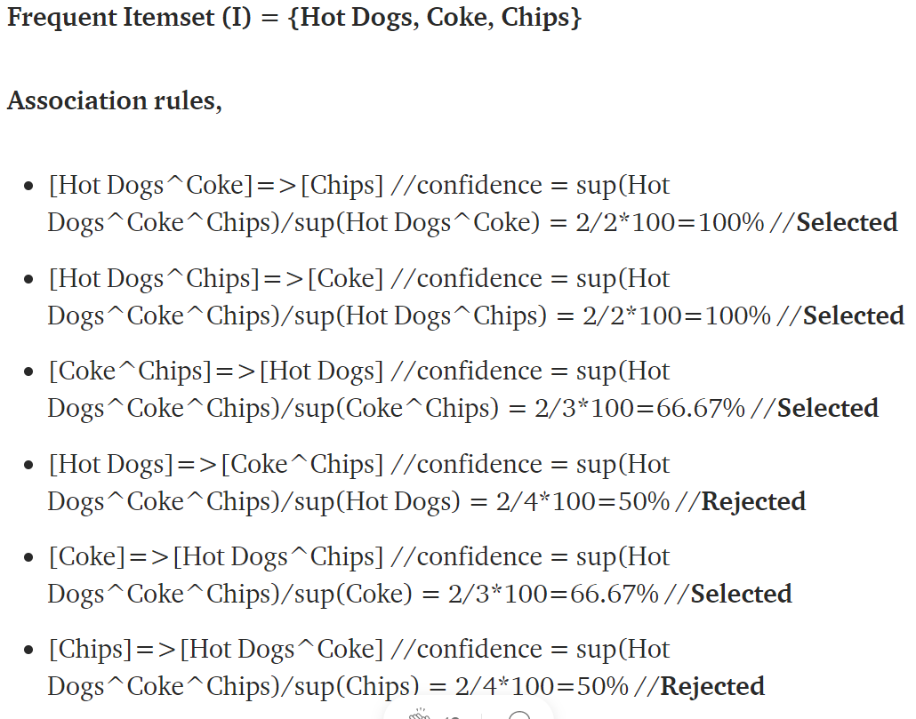

Slide 28
Partition Algorithm
Apriori scans the database (set of transactions) several times, in order to compute the supports of candidate frequent k-itemset.
The Partition Algorithm scans the database only twice.
𝖺 First scan: generate a set of all potentially large itemset
𝖺 Second scan: set up counters for each potentially large itemset and compute
their actual supports
During the first scan, a superset of the actual large itemsets is generated. (i.e. false positives may be generated, but no false negatives are generated)

Slide 29
The Partition Algorithm executes in two phases:
𝖺 Phase I: the algorithm logically divides the database into a number of non- overlapping partitions. The partitions are considered one at a time and all large itemsets for that partition are generated. At the end of phase I, these large itemsets are merged to generate a set of all potentially large itemsets.
𝖺 Phase II: the actual supports for these itemsets are generated and the large itemsets are identified.
The partition sizes are chosen such that each partition can be accommodated in the main memory so that the partitions are read only once in each phase.

Slide 30
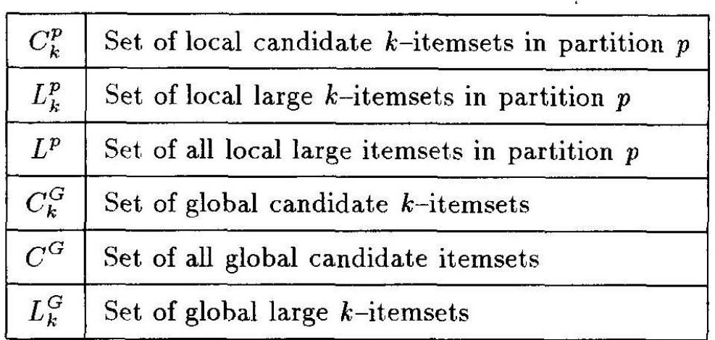
Algorithm

Slide 31
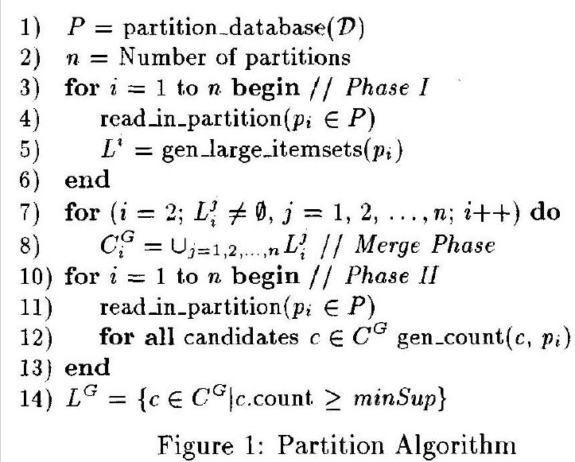
Algorithm

Slide 32
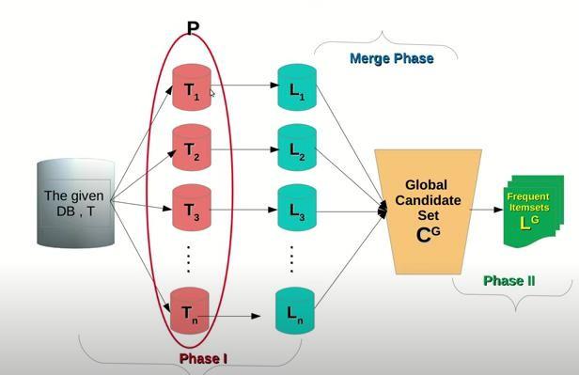

Slide 33
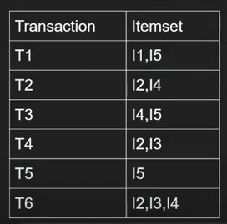
Problem

Slide 34
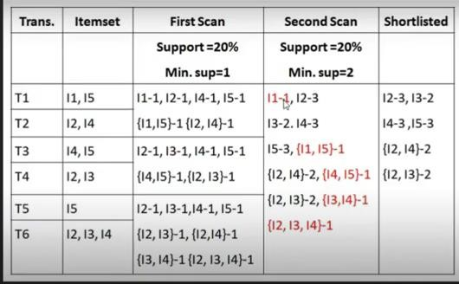
Solution

Slide 35
Pincer Search Algorithm
Apriori algorithm operates in a bottom – up,
breadth – first
search
method.
The computation starts from the smallest set of frequent item sets and moves upward till it reaches the largest frequent item set
The number of database passes is equal to the largest size of the frequent item set.
As a result, the performance decreases.

Slide 36
pincer – search algorithm is based on bi – directional search, which takes advantages of both the bottom – up as well as the top – down process.
It attempts to find the frequent item sets in a bottom – up manner but, at the same time, it maintains a list of maximal frequent item sets after pruning in the top down approach.

Slide 37
In this algorithm, in each pass, in addition to counting the supports of the candidate in the bottom – up direction, it also counts the supports of the item sets of some item sets using a top – down approach.
These are called the
Maximal Frequent Candidate Set
(MFCS).
This process helps in pruning the candidate sets very early on in the algorithm.

Slide 38
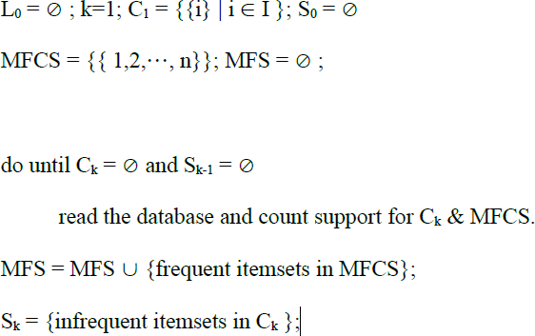


MFCS is initialized to contain one itemset, which contains all of the database items.
MFCS is updated whenever new infrequent itemsets are found
Method:

Slide 39
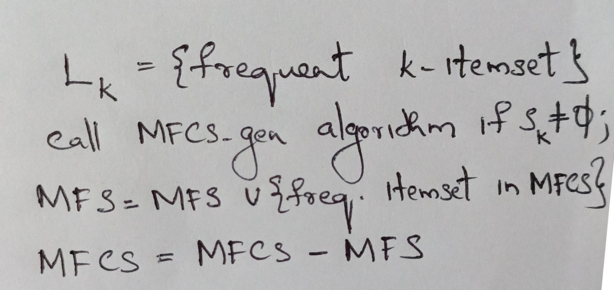
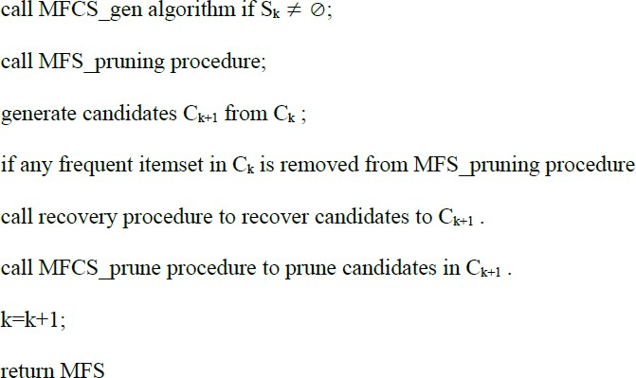

Slide 40
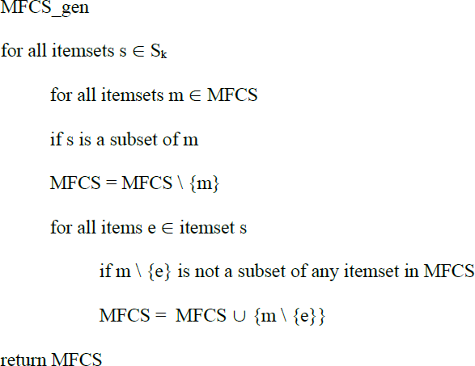

Slide 41
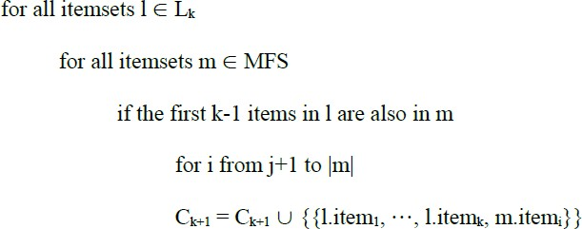
Recovery

Slide 42
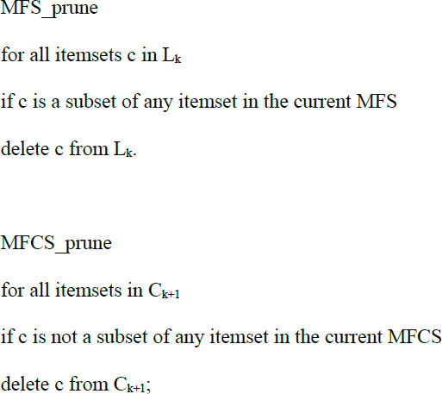

Slide 43
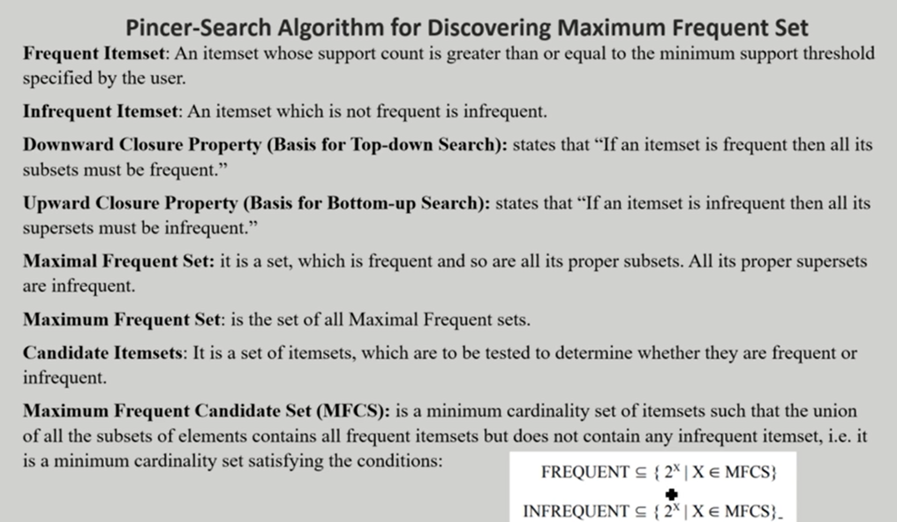

Slide 44
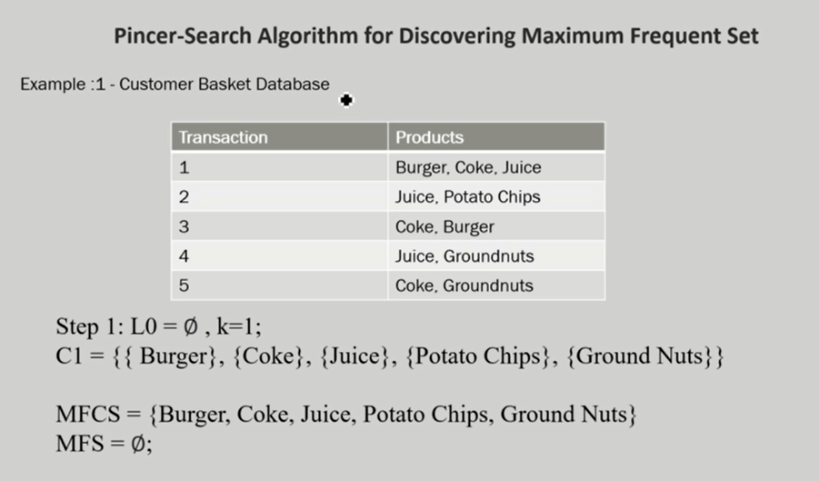

Slide 45
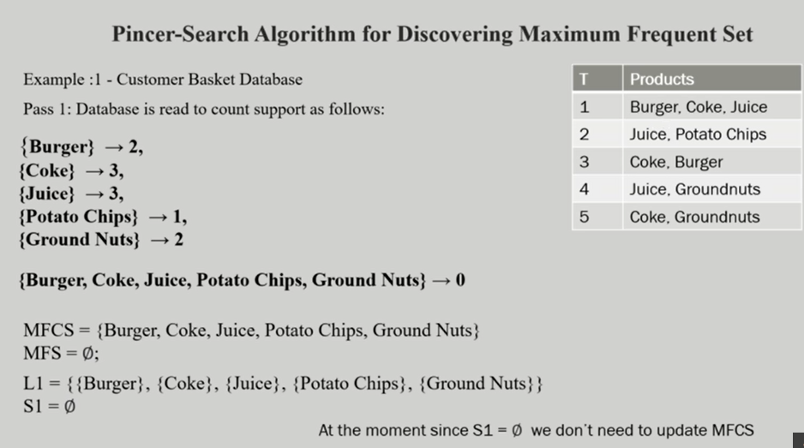

Slide 46
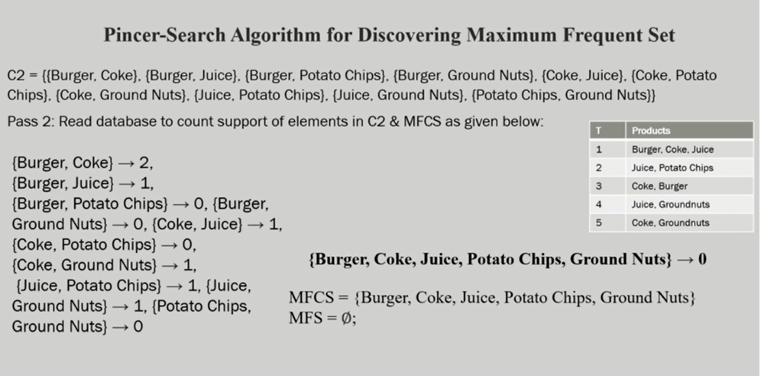

Slide 47
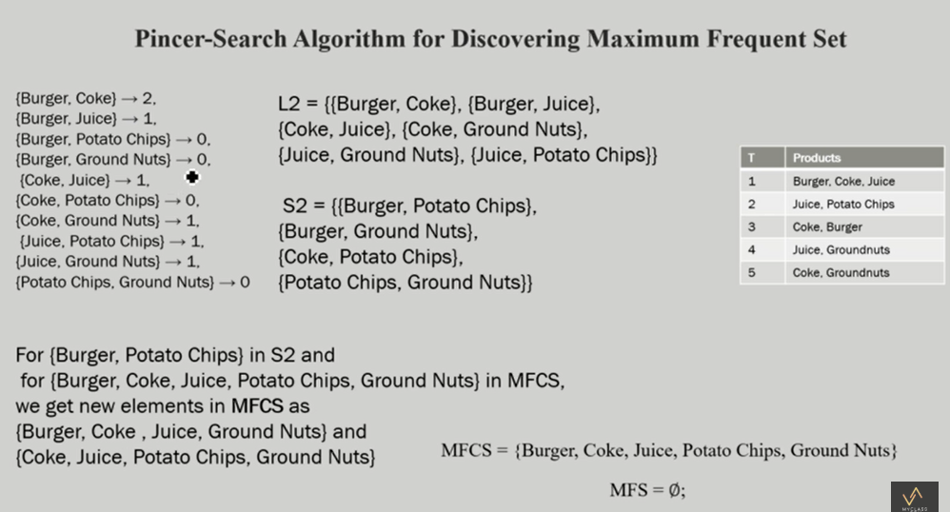

Slide 48
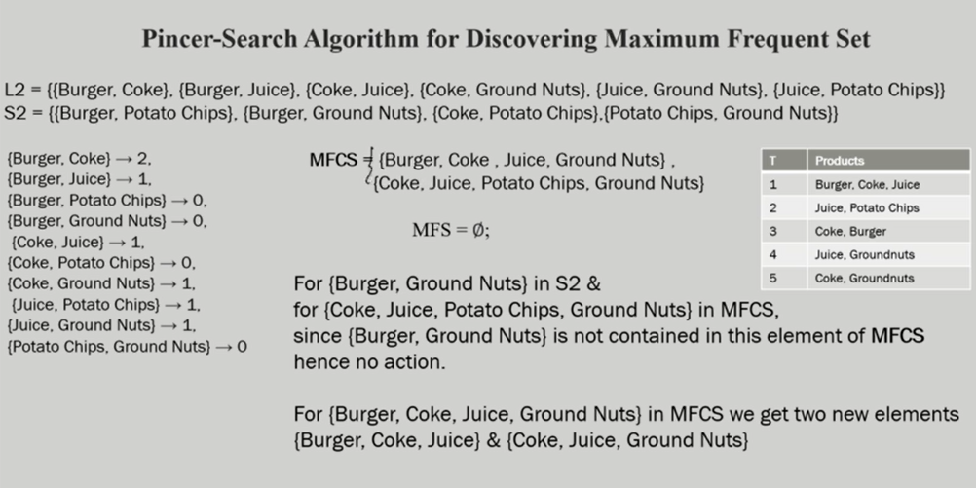

Slide 49
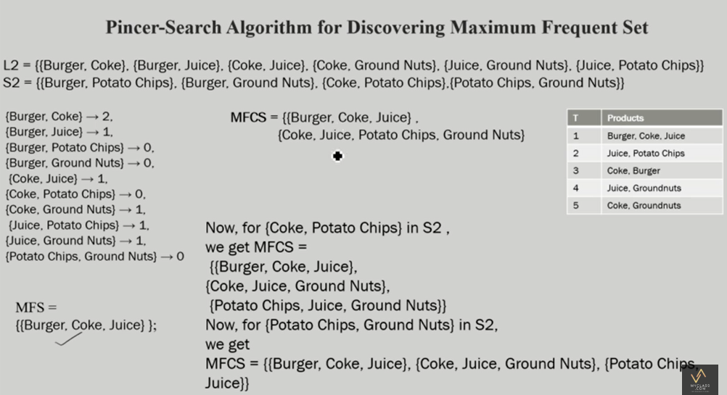

Slide 50
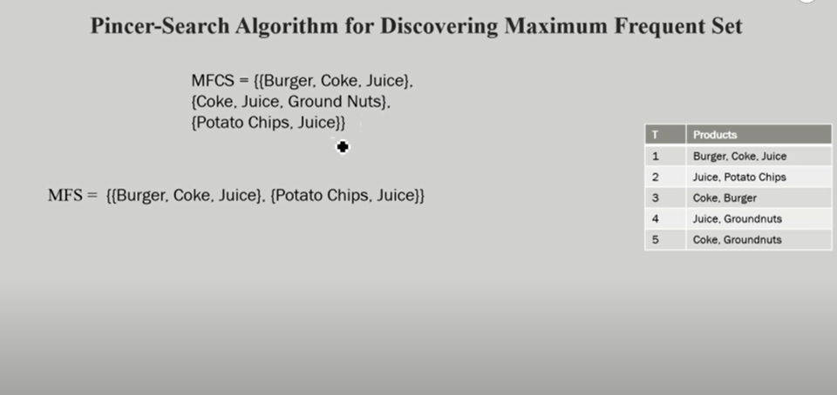

Slide 51
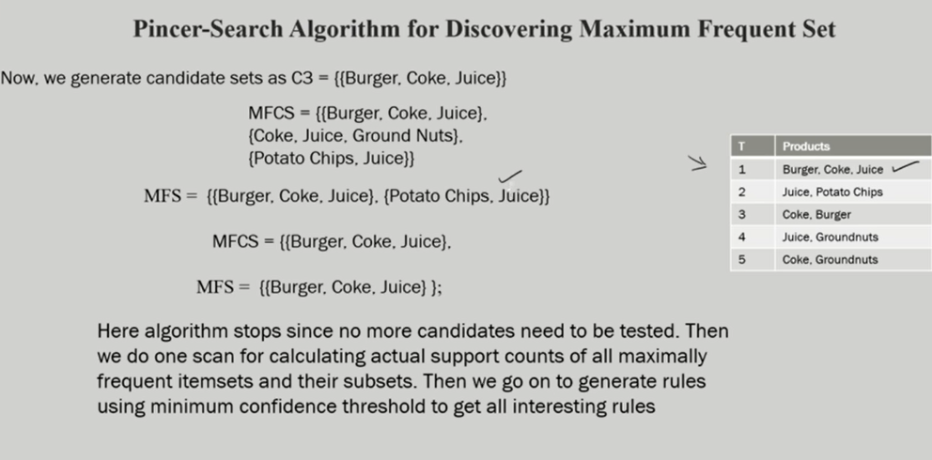

Slide 52


Problem
C1 = {{ I1}, {I2}, {I3}, {I4}, {I5}} MFCS = {I1,I2,I3,I4,I5}
MFS = Ø ;
Minimum Support=2
Pass 1: Database is read to count support as follows:
ITEM | COUNT
I2 | 7
I1 | 6
I3 | 6
I4 | 2
I5 | 2

Slide 53












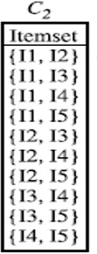
{I1,I2,I3,I4,I5} – 0
So MFCS = {I1,I2,I3,I4,I5} & MFS = Ø;
L1 = {{ I1}, {I2}, {I3}, {I4}, {I5}}
S1 = Ø, we don’t need to update MFCS
C2=

Slide 54
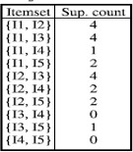




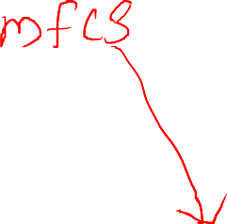

Pass 2: Read database to count support of elements in C2 & MFCS as given below:
COUNT(MFCS)=0
L2= { {I1,I3},{I1,I5},
{I2,I3},{I2,I4},{I2,I5}, {I1,I2}
S2= {{I1,I4}, {I3, I4}, },{3,I5} {I4,I5}}
S2 not empty , update MFCS

Slide 55



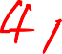
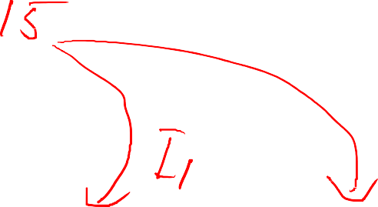
















MFCS = {I1,I2,I3,I4,I5}
S2= { {I3, I4}, {I3, I5},
{I1,I4},
{I4,I5}}
Delete {I1, I4} from MFCS one at a time
{I1,I2,I3,I4,I5}
{I2,I3,I4,I5} {I1,I2,I3,I5}
New MFCS = { {I2,I3,I4,I5} ,
{I1,I2,I3,I5} }

Slide 56







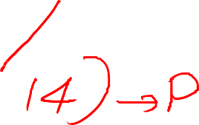












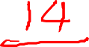






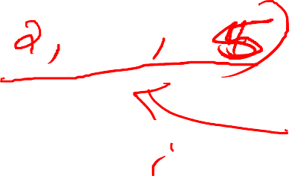







New MFCS = { {I2,I3,I4,I5} ,
{I1,I2,I3,I5} }
S2= { {I1,I4}, {I3, I4}, {I3, I5},
{I4,I5}}
Delete {I3, I4} from each item in MFCS one at a time
{I2,I3,I4,I5}
{I2,I3,I5} {I2,I4,I5}
{I3,I4} not a subset of {I1, I2,I3,I5} so no change
New MFCS ={ {I2,I3,I5},
{I2,I4,I5}, {I1,I2,I3,I5}}
• = {{I2,I4,I5}, {I1,I2,I3,I5}}

Slide 57








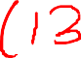





















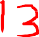



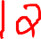







New MFCS = {{I2,I4,I5},
{I1,I2,I3,I5}}
S2= { {I1,I4}, {I3, I4},
{I4,I5}}
{I3, I5},
Delete {I3, I5} from each item in MFCS one at a time
{I1,I2,I3,I5}
{I1,I2,I5} {I1,I2,I3}
{I3,I5} not a subset of
{I2,I4,I5} so no change
New MFCS ={ {I1,I2,I5},
{I1,I2,I3}, {I2,I4,I5}}

Slide 58










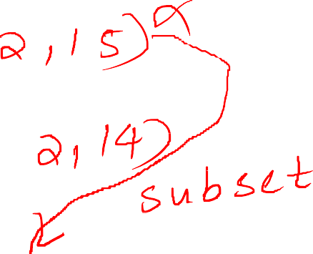






















New MFCS ={ {I1,I2,I5}, {I1,I2,I3},
{I2,I4,I5}}
S2= { {I1,I4}, {I3, I4}, {I3, I5},
{I4,I5}}
Delete {I4, I5} from each item in MFCS one at a time
{I2,I4,I5}
{I2,I4} {I2,I5}
{I3,I5} not a subset of {I1,I2,I5},
{I1,I2,I3} so no change
New MFCS ={ {I1,I2,I5}, {I1,I2,I3},
{I2,I4}}

Slide 59








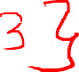
Final MFCS ={ {I1,I2,I5}, {I1,I2,I3}, {I2,I4}}
Final Output : Largest sets of three items.
MFS ={ {I1,I2,I5}, {I1,I2,I3}, {I2,I4}}
MFCS=NULL

Slide 60
Frequent Pattern Growth Algorithm
This algorithm is an improvement to the Apriori method.
A frequent pattern is generated without the need for candidate generation.
FP growth algorithm represents the database in the form of a tree called a frequent pattern tree or FP tree.
This tree structure will maintain the association between the itemsets.

Slide 61
FP Tree
Frequent Pattern Tree is a tree-like structure that is made with the initial itemsets of the database.
The purpose of the FP tree is to mine the most frequent pattern.
Each node of the FP tree represents an item of the itemset.
The root node represents null while the lower nodes represent the itemsets.
The association of the nodes with the lower nodes that is the itemsets with the other itemsets are maintained while forming the tree.

Slide 62
Problem 1
Solution
ITEM | COUNT
I2 | 7
I1 | 6
I3 | 6
I4 | 2
I5 | 2
Eliminate those item whose support count below minimum support value Here support_count = 2

Slide 63
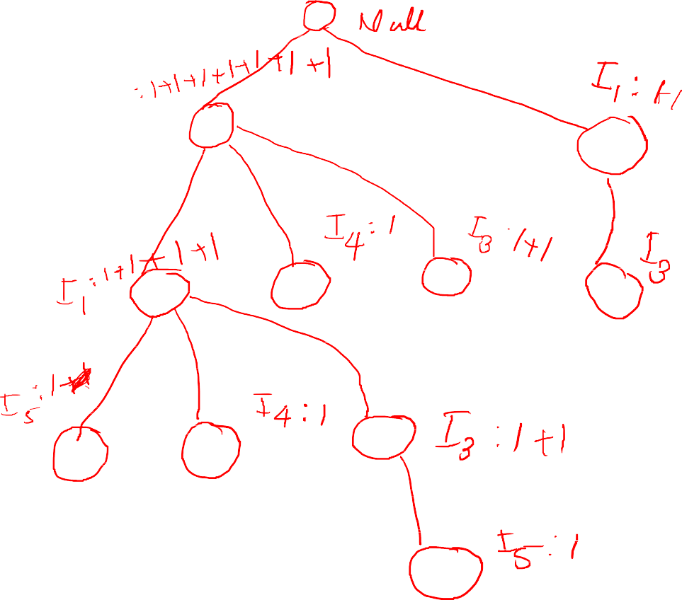


 |  | I2, I1, I5
 |  | I2, I4
 |  | I2, I3
 |  | I2, I1 I4
 |  | I1, I3
 |  | I2, I3
 |  | I1, I3
 |  | I2, I1, I3, I5
 |  | I2, I1, I3

Slide 64
Item | Conditional Pattern Base | Conditional FP Tree(with min support_count>=2) | Frequent Pattern Generated
I5 | {{I2, I1:1}, {I2, I1,I3:1} | <I2 :2, I1 : 2 > | {I2, I5 :2} {I1, I5 :2} {I2, I1, I5 : 2}
I4 | { {I2,I1:1}, {I2: 1} } | <I2 : 2> | { I2, I4 : 2}
I3 | { {I2, I1 : 2}, {I2 :2}} - left subtree {I1 : 2} – right subtree | <I2:4, I1 :2 > <I1: 2> | {I2, I3 :4} {I1, I3:4} {I2, I1, I3 : 2}
I1 | { {I2: 4}} | < I2 : 4 > | {I2, I1: 4}

Slide 65
Problem : 2
Support threshold=50%, Confidence= 60%
Transaction | List of items
T1 | I1,I2,I3
T2 | I2,I3,I4
T3 | I4,I5
T4 | I1,I2,I4
T5 | I1,I2,I3,I5
T6 | I1,I2,I3,I4
Solution:
Support threshold=50% => 0.5*6= 3 => min_sup=3

Slide 66
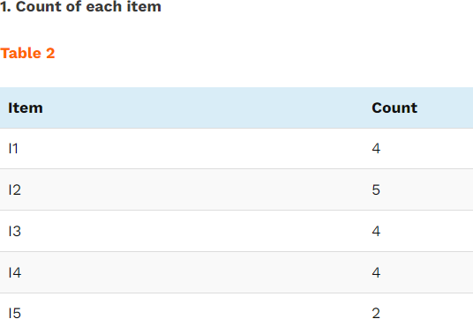

Slide 67


Slide 68


Slide 69


Slide 70
Advantages Of FP Growth Algorithm
This algorithm needs to scan the database only twice when compared to Apriori which scans the transactions for each iteration.
The pairing of items is not done in this algorithm and this makes it faster.
The database is stored in a compact version in memory. 4.It is efficient and scalable for mining both long and
short frequent patterns.

Slide 71



Let the minimum support be 3

Slide 72

Ordered-Item set

Slide 73



a) Inserting the set {K, E, M, O, Y}:
b) Inserting the set {K, E, O, Y}:
c) Inserting the set {K, E, M}:

Slide 74


d) Inserting the set {K, M, Y}:
e) Inserting the set {K, E, O}

Slide 75


Conditional Pattern Base
Conditional Frequent Pattern Tree

Slide 76

Frequent Pattern rules

Slide 77
Disadvantages Of FP-Growth Algorithm
FP Tree is more difficult to build than Apriori.
It may be expensive.
When the database is large, the algorithm may not fit in the shared memory

Slide 78
FP Growth vs Apriori
FP Growth | Apriori
Pattern Generation
FP growth generates pattern by constructing a FP tree | Apriori generates pattern by pairing the items into singletons, pairs and triplets.
Candidate Generation
There is no candidate generation | Apriori uses candidate generation
Process
The process is faster as compared to Apriori. The runtime of process increases linearly with increase in number of itemsets. | The process is comparatively slower than FP Growth, the runtime increases exponentially with increase in number of itemsets
Memory Usage
A compact version of database is saved | The candidates combinations are saved in memory

Slide 79
Dynamic Itemset Counting Algorithm
Alternative to Apriori Itemset Generation
Itemsets are dynamically added and deleted as transactions are read
Relies on the fact that for an itemset to be frequent, all of its subsets must also be frequent, so we only examine those itemsets whose subsets are all frequent

Slide 80
Itemsets are marked in four different ways as they are counted:
Solid box: confirmed frequent itemset - an itemset we have finished counting and exceeds the support threshold minsupp
Solid Circle: confirmed infrequent itemset - we have finished counting and it is below minsupp
Dashed box: suspected frequent itemset - an itemset we are still counting that exceeds minsupp
Dashed Circle: suspected infrequent itemset - an itemset we are still counting that is below minsupp

Slide 81
DIC Algorithm
Mark the empty itemset with a solid square. Mark all the 1-itemsets with dashed circles. Leave all other itemsets unmarked.
While any dashed itemsets remain:
Read M transactions (if we reach the end of the transaction file, continue from the beginning). For each transaction, increment the respective counters for the itemsets that appear in the transaction and are marked with dashes.
If a dashed circle's count exceeds minsupp, turn it into a dashed square. If any immediate superset of it has all of its subsets as solid or dashed squares, add a new counter for it and make it a dashed circle.
Once a dashed itemset has been counted through all the transactions, make it solid
and stop counting it.

Slide 82
Itemset lattices: An itemset lattice contains all of the possible itemsets for a transaction database. Each itemset in the lattice points to all of its supersets. When represented graphically, a itemset lattice can help us to understand the concepts behind the DIC algorithm

Slide 83




Problem
Example: minsupp = 25% (support count= 0.25*4=1) and M = 2.

Slide 84











Slide 85












Slide 86












Slide 87






Slide 88


Slide 89



















Slide 90


Slide 91

Example

Slide 92



Slide 93


Slide 94



Slide 95


